Slide 1

IT Application Project Proposal
By Kayden Zachariah Tan Kai De, Lee Zheng Bo,
Cheam Zhi Yi Chia Jin Lei, Jeremy

Slide 2

Company, Context & Aim
Company: LEGO Bricks Pte Ltd.
A Construction Company based in Singapore and has been in service for up to 2 years
They help in the construction of government contracts and projects

Slide 3

Company, Context & Aim
However, Controversies have sparked in the company whereby construction wastes were not disposed and recycled properly.
This led to criticisms and officials made it mandatory for the company to improve or actions will be taken.

Slide 4


Company, Context & Aim
Our Aim
To create a Company Gaming Educational Application
Teach Workers about sustainability and proper waste disposal
Form more experienced and prepare employees

Slide 5
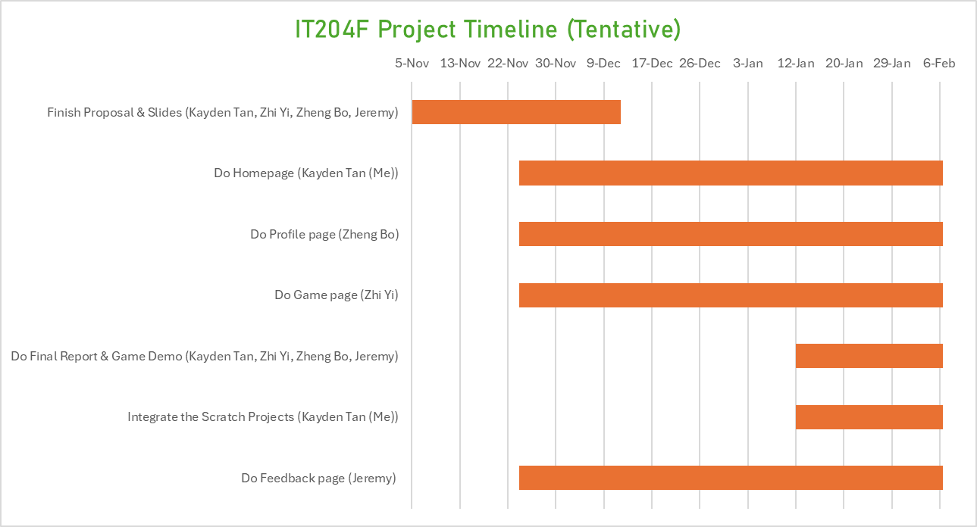
Schedule/Timeline Gantt Chart (Tentative)

Slide 6
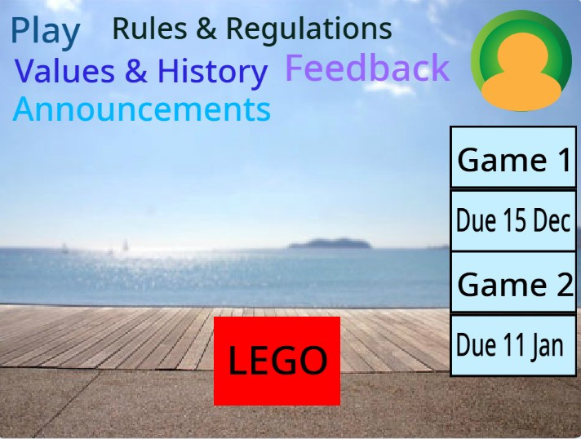
Homepage
Navigation Menu for users to navigate the site
Users can also access the Feedback Form in the menu to provide their feedback

Slide 7
Homepage
Profile button to access a worker’s profile or to sign out
Company logo, which can also be clicked to access a pop-up
Announcement system with pop-ups to remind users

Slide 8
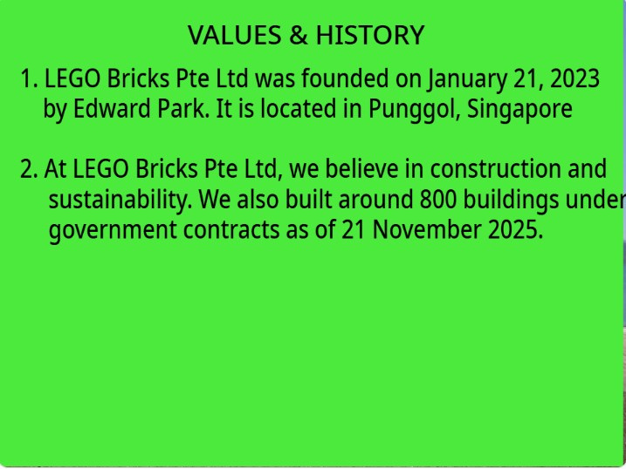
Homepage
One of the pop-ups that display the values and history of the company after the user clicks on the navigation menu or the company logo.

Slide 9
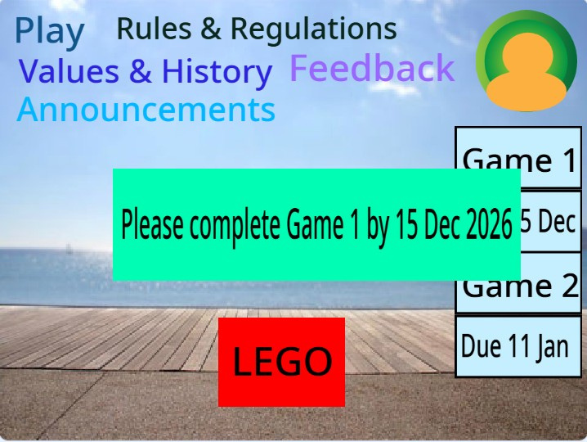
Homepage
One of the pop-ups that displays an announcement, which informs the user that he/she needs to complete the game by a certain date.

Slide 10
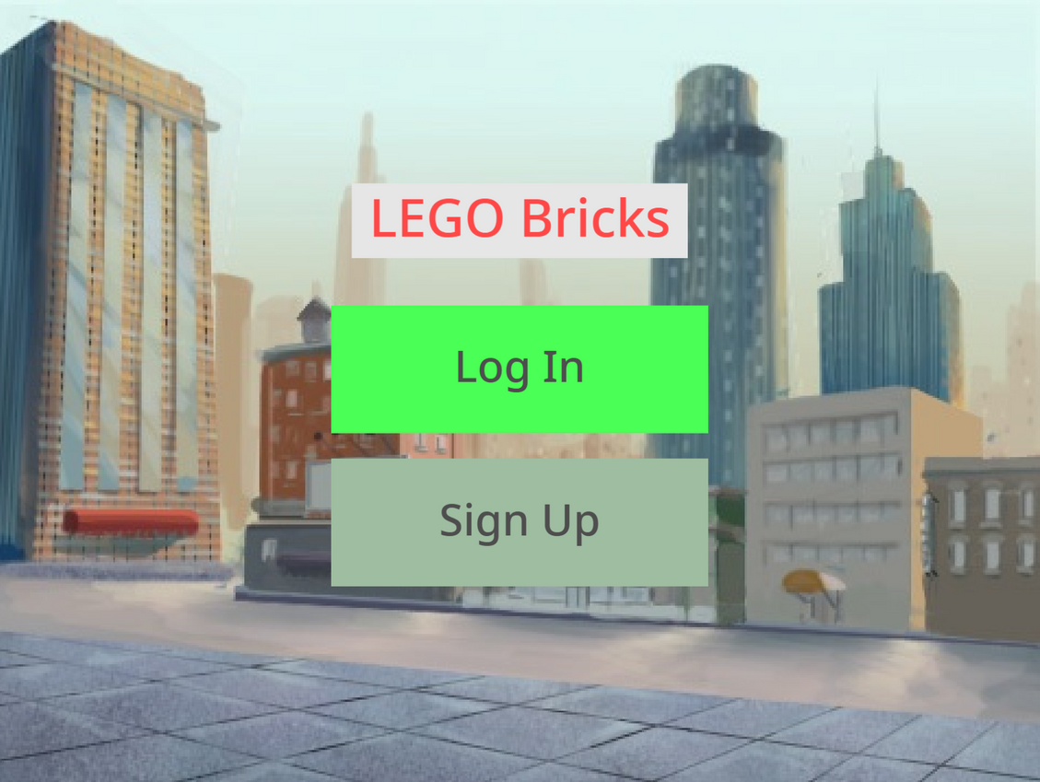
Profile
Log-In and Sign-Up page
Required action to access games
Create or enter an account
Employee’s quality check
Ensure users are ready

Slide 11
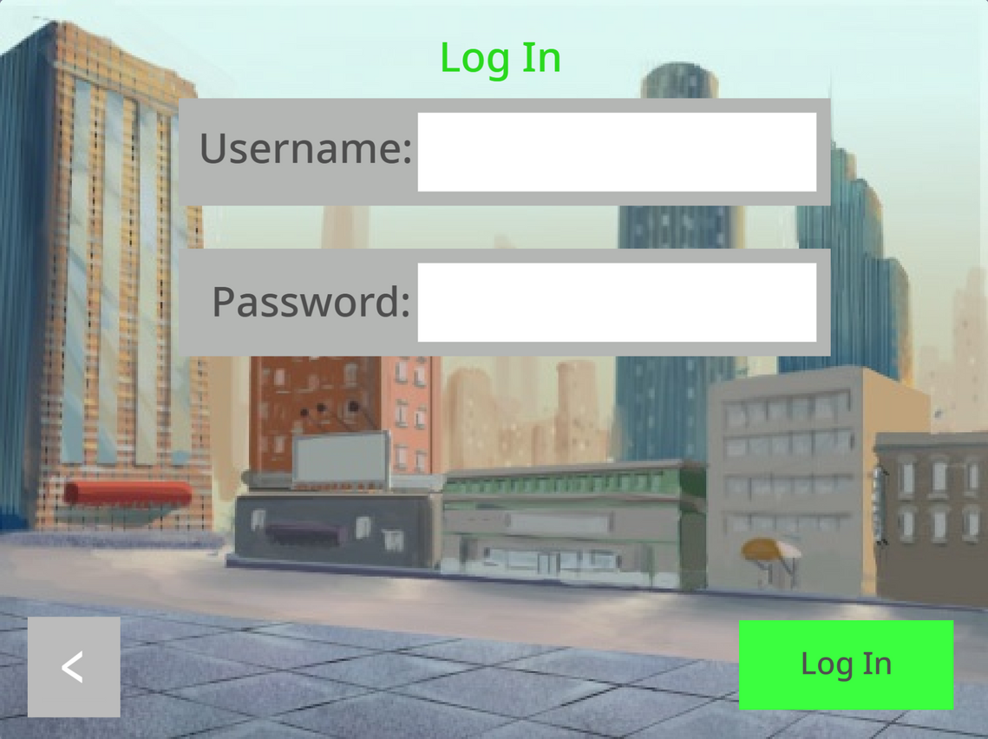
Profile
Log-in account
Must enter matching user and password
Security for accounts to prevent grade impacts made by wrong individuals

Slide 12
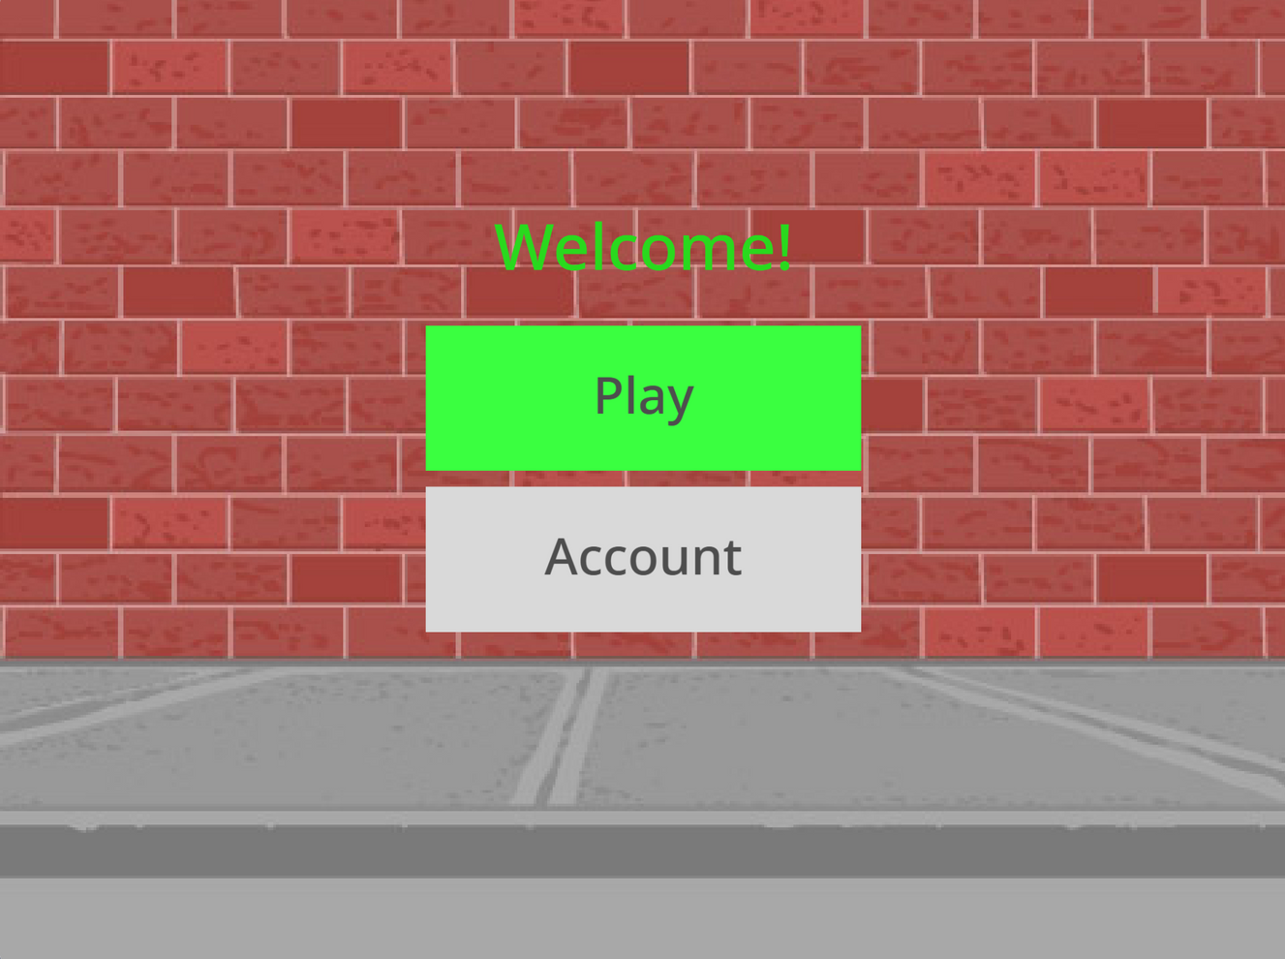

Profile

Slide 13
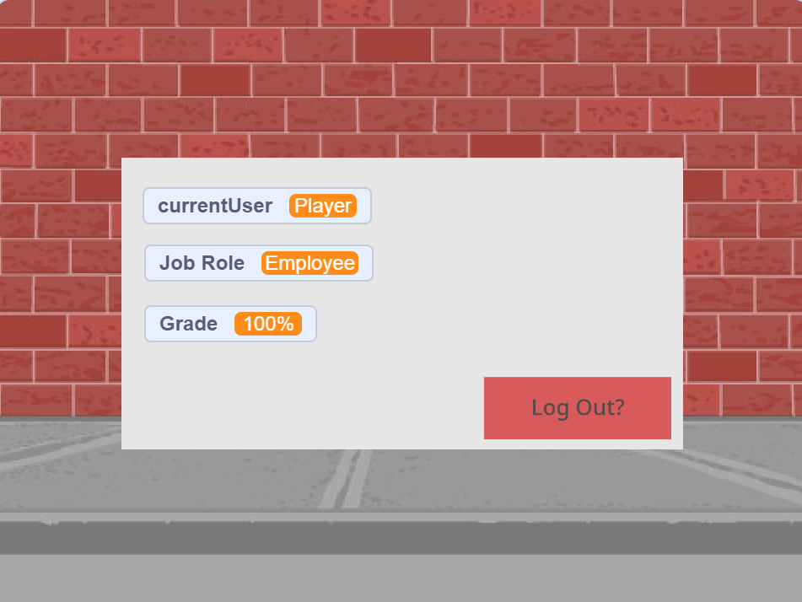
Profile
Viewable Account statuses
Current User
Job Role
Scores can be earned from games
Grading = Score Earned/Max Score
Higher Grade = More Ready

Slide 14
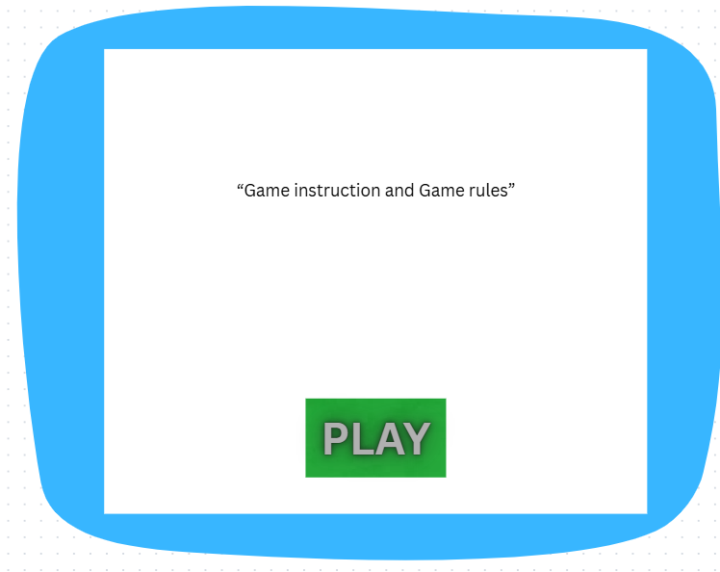
Game
A form of educational entertainment
Game instruction (important for users to know how to play)
Game rules (How to score points)

Slide 15
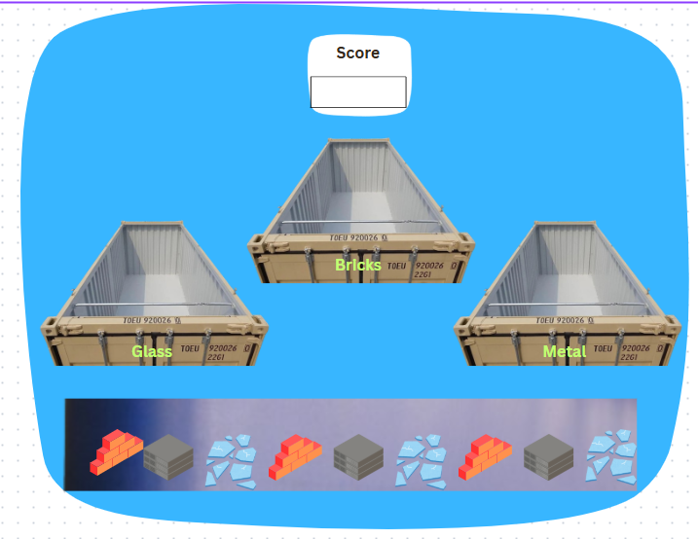
Game
Game (Users way of learning)
Score System (Grading system of how well they did)
Fun challenges (Gain player interaction)

Slide 16
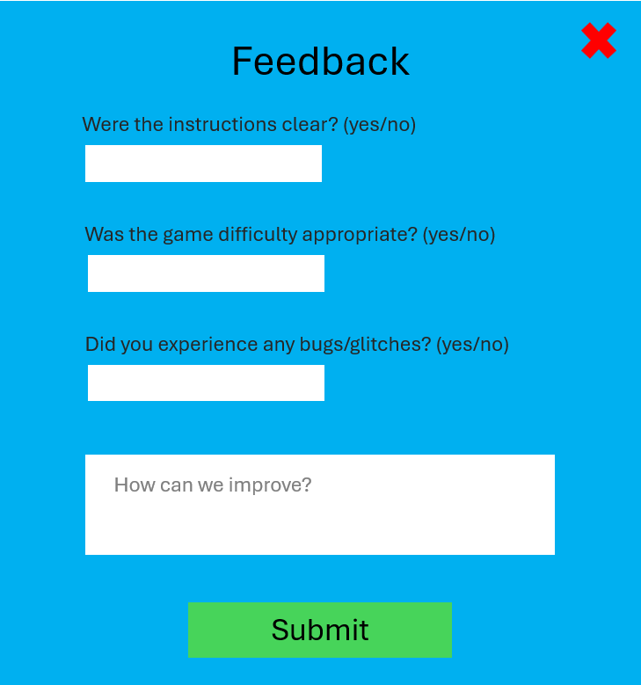
Feedback
Accessible via the homepage
Collects valuable user feedback
Questions regarding application usability
Evaluate on how we can improve the app’s user experience

Slide 17
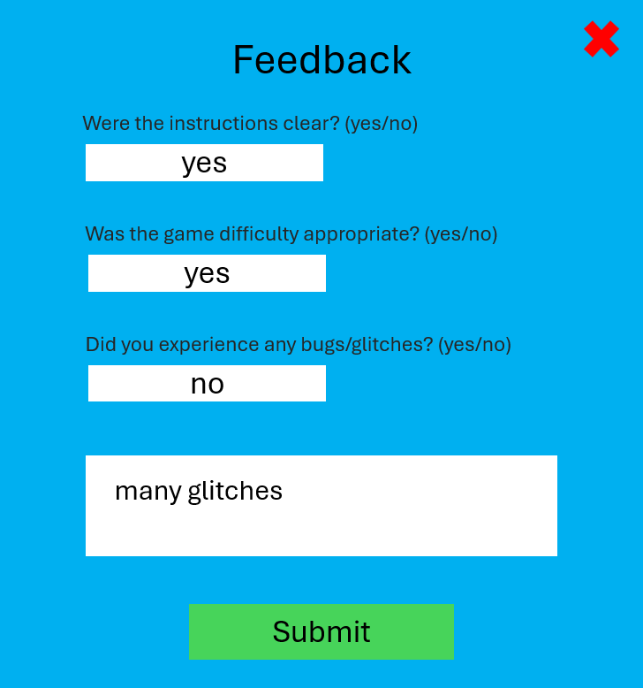
Feedback
Accessible via the homepage
Collects valuable user feedback
Questions regarding application usability
Evaluate on how we can improve the app’s user experience

Slide 18
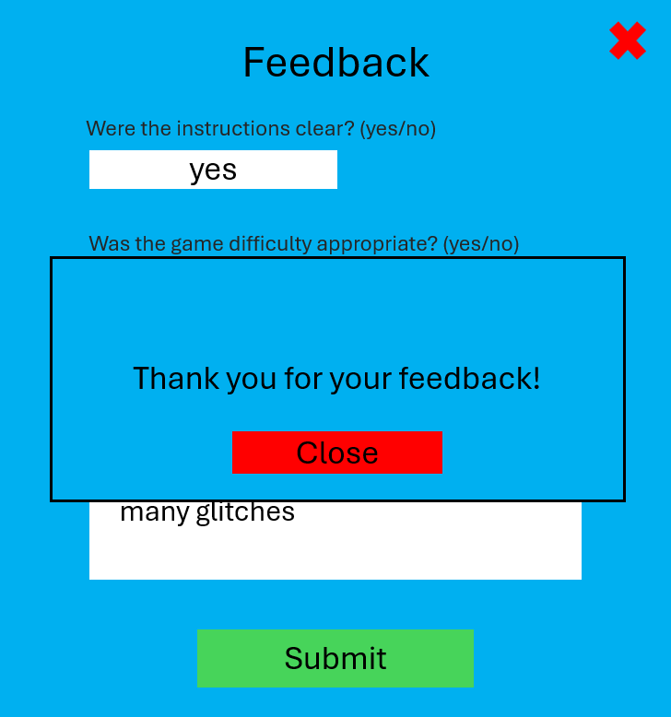
Feedback
Accessible via the homepage
Collects valuable user feedback
Questions regarding application usability
Evaluate on how we can improve the app’s user experience

Slide 19
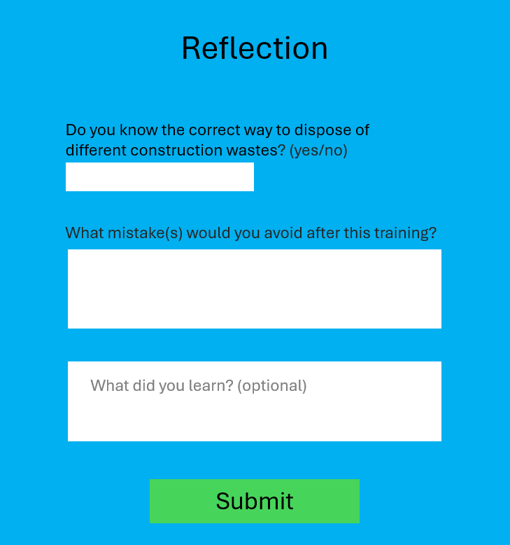
Reflection Form
Accessible after completing the game
Questions regarding learning effectiveness
Evaluate on how we can improve the app’s learning effectiveness

Slide 20
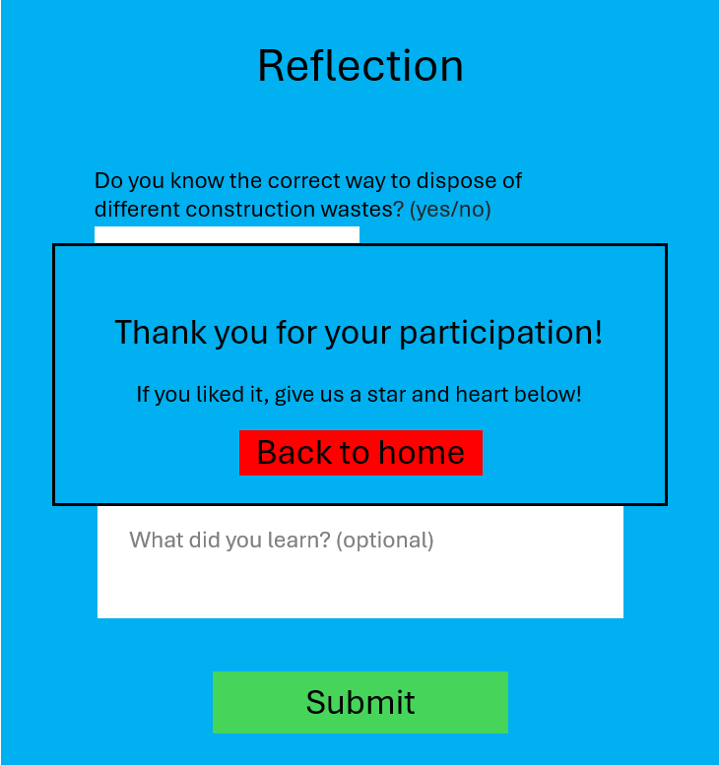
Reflection Form
Accessible after completing the game
Questions regarding learning effectiveness
Evaluate on how we can improve the app’s learning effectiveness

Slide 21
End of Presentation

